Slide 1



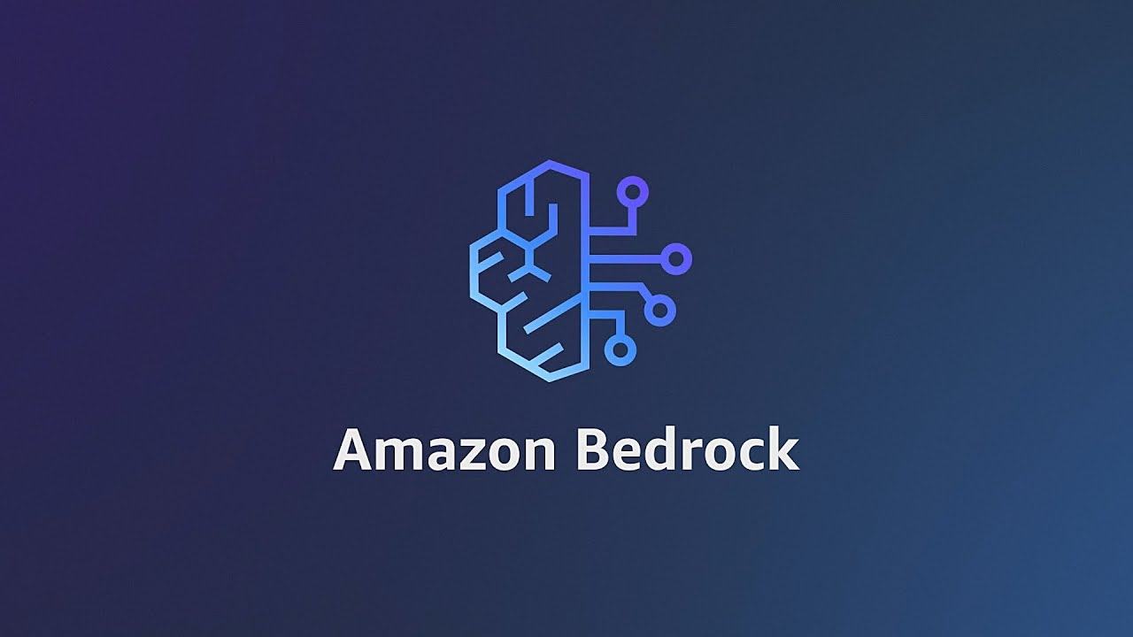

Introduction to Amazon Bedrock
Speaker: Isham Rashik
AI Engineer at KNAI / AI Community lead under CodersHQ

Slide 2
Introduction about myself
Brought up in UAE - residing more than 27 years - from primary school till completing Masters.
BEng. Electrical And Electronic Engineer and MBA in Finance and Operations
Worked in multiple sectors - Education, Finance, Telecom, Media, and Research & Development
Currently working as AI Engineer working at KNAI.
Involved in both Classical Machine Learning and Generative AI projects
Overall more than 6 years in the field of State of the Art Technology
Top Voice in Machine Learning, Data Science and Machine Learning on Linkedin from August 2023 till February 2024
Currently also AI Community lead under CodersHQ and one of the Co-Founders of Launchpad.

Slide 3









Slide 4
Today’s Agenda
What is Amazon Bedrock and its key features
Major AI Companies that have deployed the Foundation Models
Pricing of the models
Setting up of IAM Account for AWS Bedrock Service
Model Access
Example use cases
Final Demo – YouTube Notes Generator

Slide 5
What is Amazon Bedrock and its key features?

Slide 6

Amazon Bedrock - Overview
Fully managed service for Foundation Models (FMs)
Access FMs from leading AI startups and Amazon via API
Choose from a wide range of FMs for your specific use case
Serverless experience for quick start

Slide 7
Key Features
Unifies models from various providers into a single point
No need to worry about deployment and scalibility
Reliable and secure as the data remains private
Models are provided from the best AI companies in the world
Easy customization of models and fine tuning

Slide 8

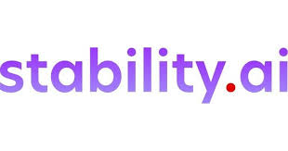
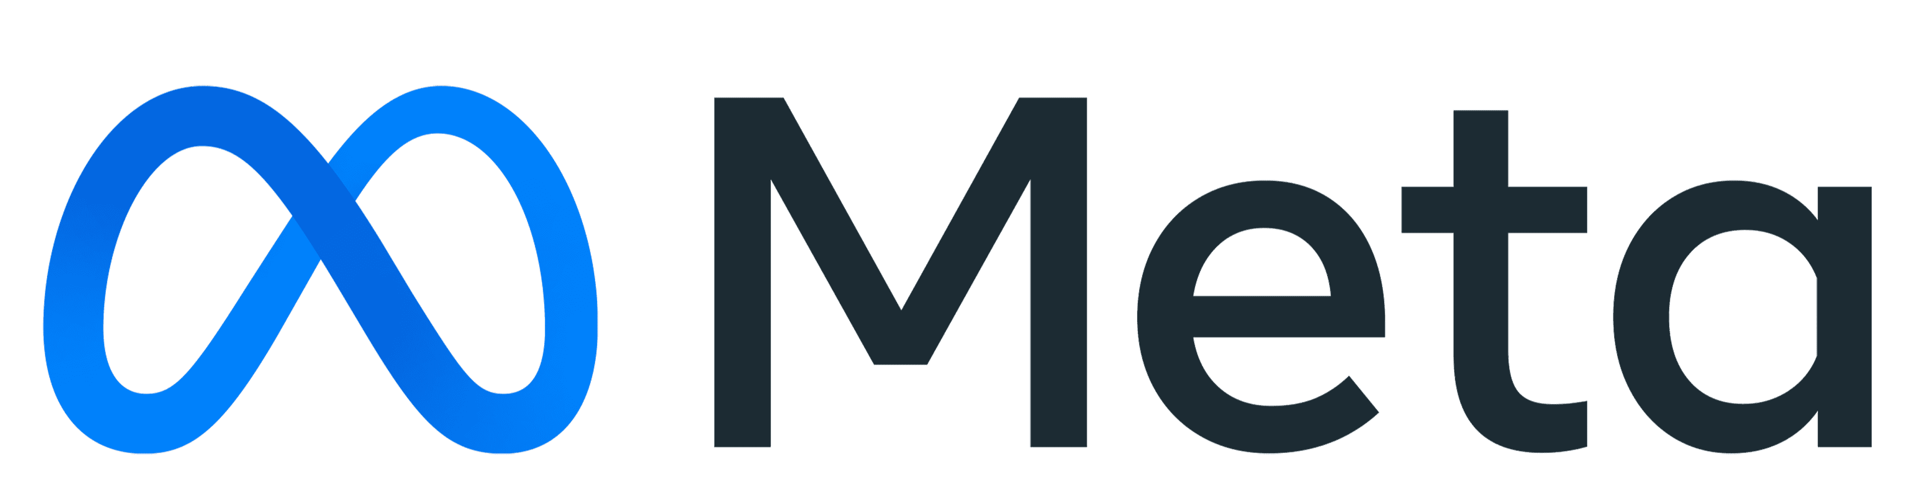



Leading AI Companies providing FMs via Bedrock

Slide 9
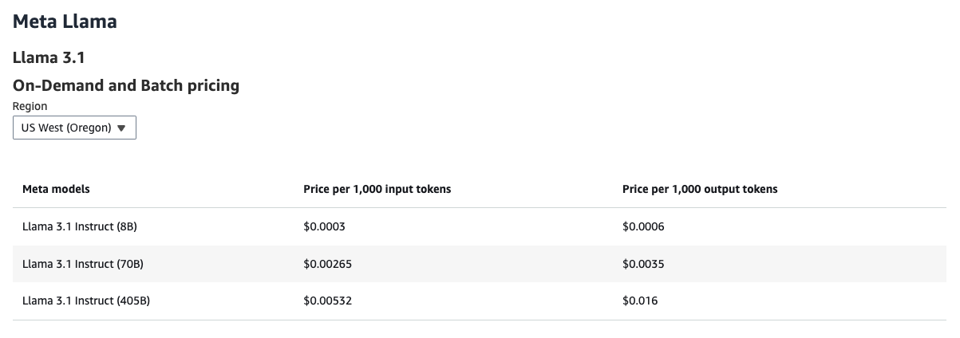
Pricing of the Models
To explore price of more model, visit: https://aws.amazon.com/bedrock/pricing/

Slide 10
Setting up of IAM Account for AWS Bedrock Service

Slide 11
Model Access - Demo

Slide 12
Playground and API - Demo
Notes:
Examples:
Chain

Slide 13

Playground and API - Demo
Image Generation - SDXL v1.0 - Playground Example
We will be using Llama3.1 model family – 8B, 70B and 405B – state of the art models
Running Inference via API using InvokeModel and InvokeModelWithResponseStream – Dedicated App
Use AWS Bedrock Converse API – Basic Streaming Chatbot – Conversational App
Final demo – YouTube Notes Generator

Slide 14
🎥 YouTube Notes Generator – Demo 📝

Slide 15

What to do next
Try out different models like Cohere, Mistral Large – little tweaks in parameters required
Build your own RAG application – Chat with PDF, Chat with SQL and Knowledge Graph Databases
Build memory persistent chatbot – using AWS DynamoDB, Postgresql etc
Documentation: https://docs.aws.amazon.com/bedrock/latest/userguide/what-is-bedrock.html

Slide 16
Question and Answer Session

Slide 17

Download materials
Link: https://github.com/di37/aws-bedrock-presentation

